Slide 1

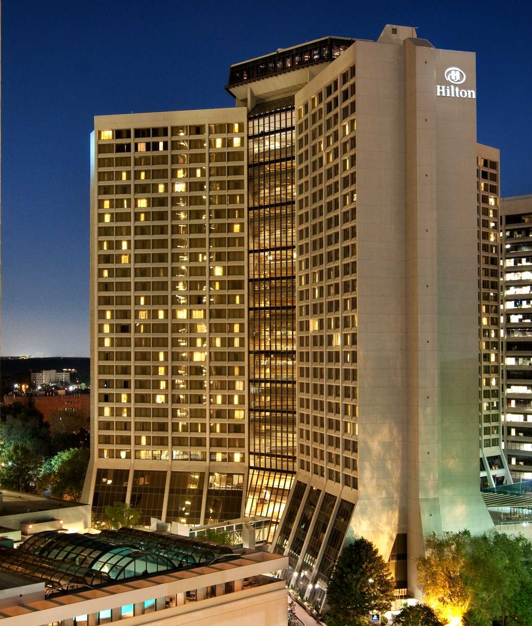
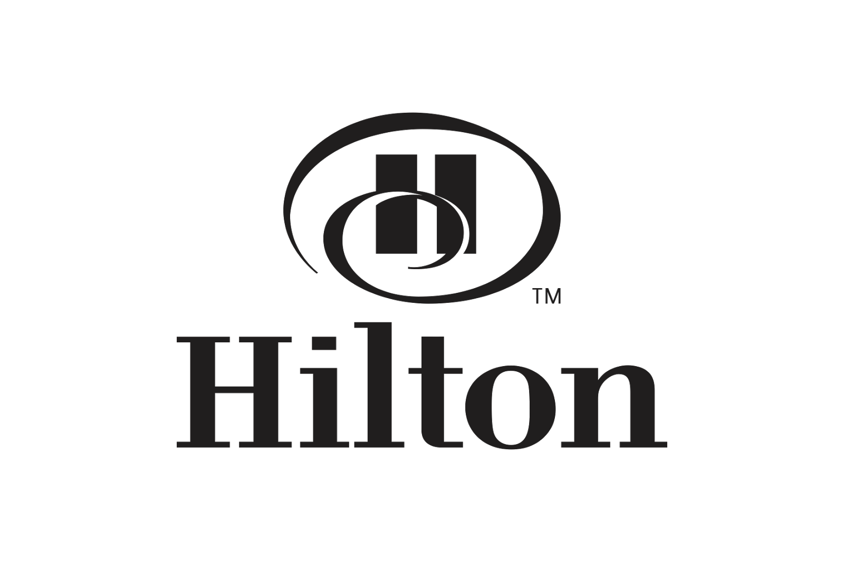

Slide 2


H³
Represents
HOSPITALITY
HONORS
HOTECH
represents
e-services
represents
loyalty programs
represents
Hospitality technology &
Smart hotel

Slide 3
OBJECTIVES

Slide 4
Guests leverage multiple devices to engage with these experiences. Are there any differences in activity based on device type and experience? Does the guest type, instead of device type, drive any of these differences?
REACH
CONVERT
ENGAGE
ACT
What signals in the data provided can help distinguish whether a trip represents business, leisure, or “bleisure” travel? For those purely leisure guests, what information would you use to make recommendations on specific leisure destinations they should consider? Where on the digital properties would you make these recommendations and why?
APPROACH
What are some differentiating digital behaviors among guests who book through Hilton-owned digital channels and online travel agents (OTAs)? Are any opportunistic moments within the digital booking flow where Hilton could intervene to encourage direct bookings before a guest goes to an OTA?

Slide 5
KEY DATA DRIVEN QUESTIONS
REACH
CONVERT
ENGAGE
ACT
1. How Hilton is segmenting and targeting the audience ?
2. Which media is being used to create awareness ?
1. How customers are interacting with Hilton Honors app & websites?
2. Which marketing channels are generating leads?
1. How leads are being converted to members of the hotel?
2. Which strategies are being implemented to drive customers
to direct channels than OTAs?
1. How customers are turning to advocates ?
2. How customers are promoting Hilton brands ?

Slide 6
OBSERVATIONS

Slide 7
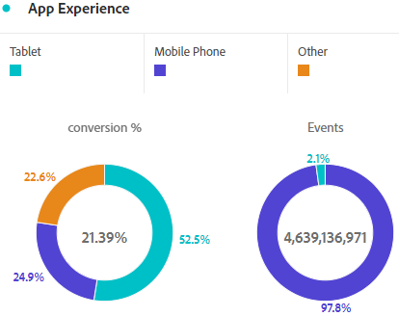


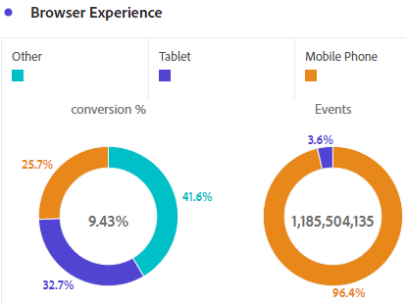
Are there any differences in activity based on device type and experience? Does the guest type, instead of device type, drive any of these differences?
Mobile
Desktop
More engagement is seen in app and web
BEST MARKETING CHANNELS (conversion%) :
APP
Metasearch-4.63%, Paid search-4.47%
& Referring domains-3.68%
WEB
Other links-9.25%,Affiliates-8.43%&
Metasearch-5.5%
GUEST TYPE (honors tier):(no of loyal customers)
no of loyal customers = digital reservations/person>2
APP->Diamond - 0.8M , Silver - 0.6M , Gold - 0.4M
WEB->Diomond-0.39M , Silver- 0.36M ,Gold – 0.25M
More conversions is seen in web
BEST MARKETING CHANNELS (conversion%) :
conversion%=digital reservations/sessions
APP
Display-6.45%,Metasearch-5.6%,Paid search-4.82%
WEB
Other links-8.9%,Metasearch-6.28%
&Affiliates-5.52%
GUEST TYPE(honors tier):(no of loyal customers)
Silver – 131 Gold – 65
Diamond – 105 Members - 62
SUGGESTION BOX
Invest more on best working marketing channels of mobile and desktop to increase awareness
Introduce new features in honors mobile app since more loyal customers are being engaged.
Modify the web UI since less people are interacting with it.

Slide 8
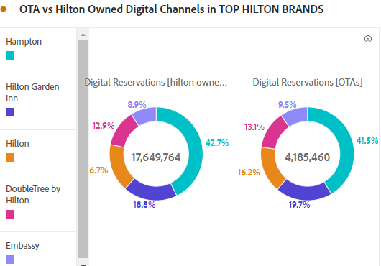

What are some differentiating digital behaviors among guests who book through Hilton-owned digital channels & OTAs?
Customers are opting OTAs over Hilton owned channels because of following reasons:
Good display of customer review page
Accommodations and transportation services like flight bookings , car rentals , airport taxi are at one place.
Exposure to wide range of hotels and scope to compare hotels is possible.
Are any opportunistic moments within the digital booking flow where Hilton could intervene to encourage direct bookings before a guest goes to an OTA?
OTAs set charges for booking cancellation. By setting effective refund policy in Hilton , customers may show more interest in direct booking .
Providing transportation services (car rentals) such that customers can get discounts & also earn points .
Focus on reviews as
Positive reviews – act as electronic word of mouth , fill information gaps.
Negative reviews – replying to negative reviews will build customer loyalty.
Quick Fact :
A recent Barclays study reveals there is an extra £3.2 billion to be earned over the next decade if the hotel sector becomes more attentive to online reviews.

Slide 9
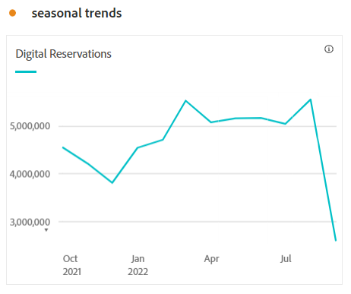
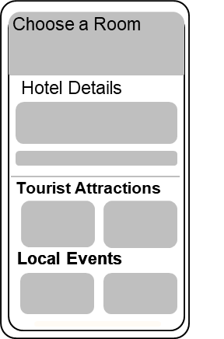
What signals in the data provided can help distinguish whether a trip represents business, leisure, or “bleisure” travel?
Leisure:
More digital reservations are found on weekends
Most seasonal holidays
Customers include children .
Business or Bleisure :
Customers book meeting rooms or business centers
Most digital reservations found on weekdays .
For those purely leisure guests, what information would you use to make recommendations on specific leisure destinations they should consider? Where on the digital properties would you make these recommendations and why?
Create customer’s persona by demographic(age , gender , location ,social media habits , spoke language) and psychographics(travel activities ,expectations while travelling) segmentation .
From the provided info we recommend popular local destinations , events , activities , festive events , etc.
Using social media analytics( Facebook , Insta ) to target the public by sending them ads , update them with latest info about Hilton with social media marketing .

Slide 10
RECOMMENDATIONS

Slide 11
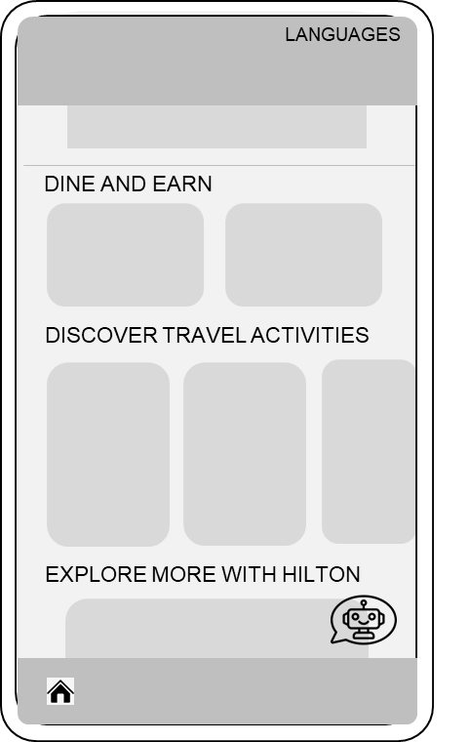
REDESIGN
Redesign home page of app to increase customer engagement and time since traffic is more in mobile app .
Add language feature .
Add videos of hotel infrastructure which increases interest & time spent by customer also reduces the bounce rate according to the study of video hosting company Wistia .
Add bucket brigade phrases in the content area to catch customer’s attention .
Add a back link to the hotel name to redirect customers to that particular hotel web page .
Add check boxes in find a hotel section showing the purpose of travel ( business , leisure & bleisure ) to collect
data and use strategies accordingly.
Display all the reviews & introduce C2C interaction feature in review page.
Add weather report feature.

Slide 12
POEM FRAMWORK marketing strategy to increase Hilton’s revenue and awareness.
PAID
Media
OWNED
Media
EARNED
Media
1. Provide booking facility of local restaurants.
2. Provide private tourism facilities.
3. Provide local tourist activities.
Advantages (By opting the above features customers will get) :
Better UX
Give discount & get points.
1. Display all reviews and introduce C2C interaction features in reviews page so that it acts as word of mouth and drives customers directly to Hilton channels than OTAs.
1. Popularise Hilton brands by organising events and display it in digital channels of Hilton.

Slide 13
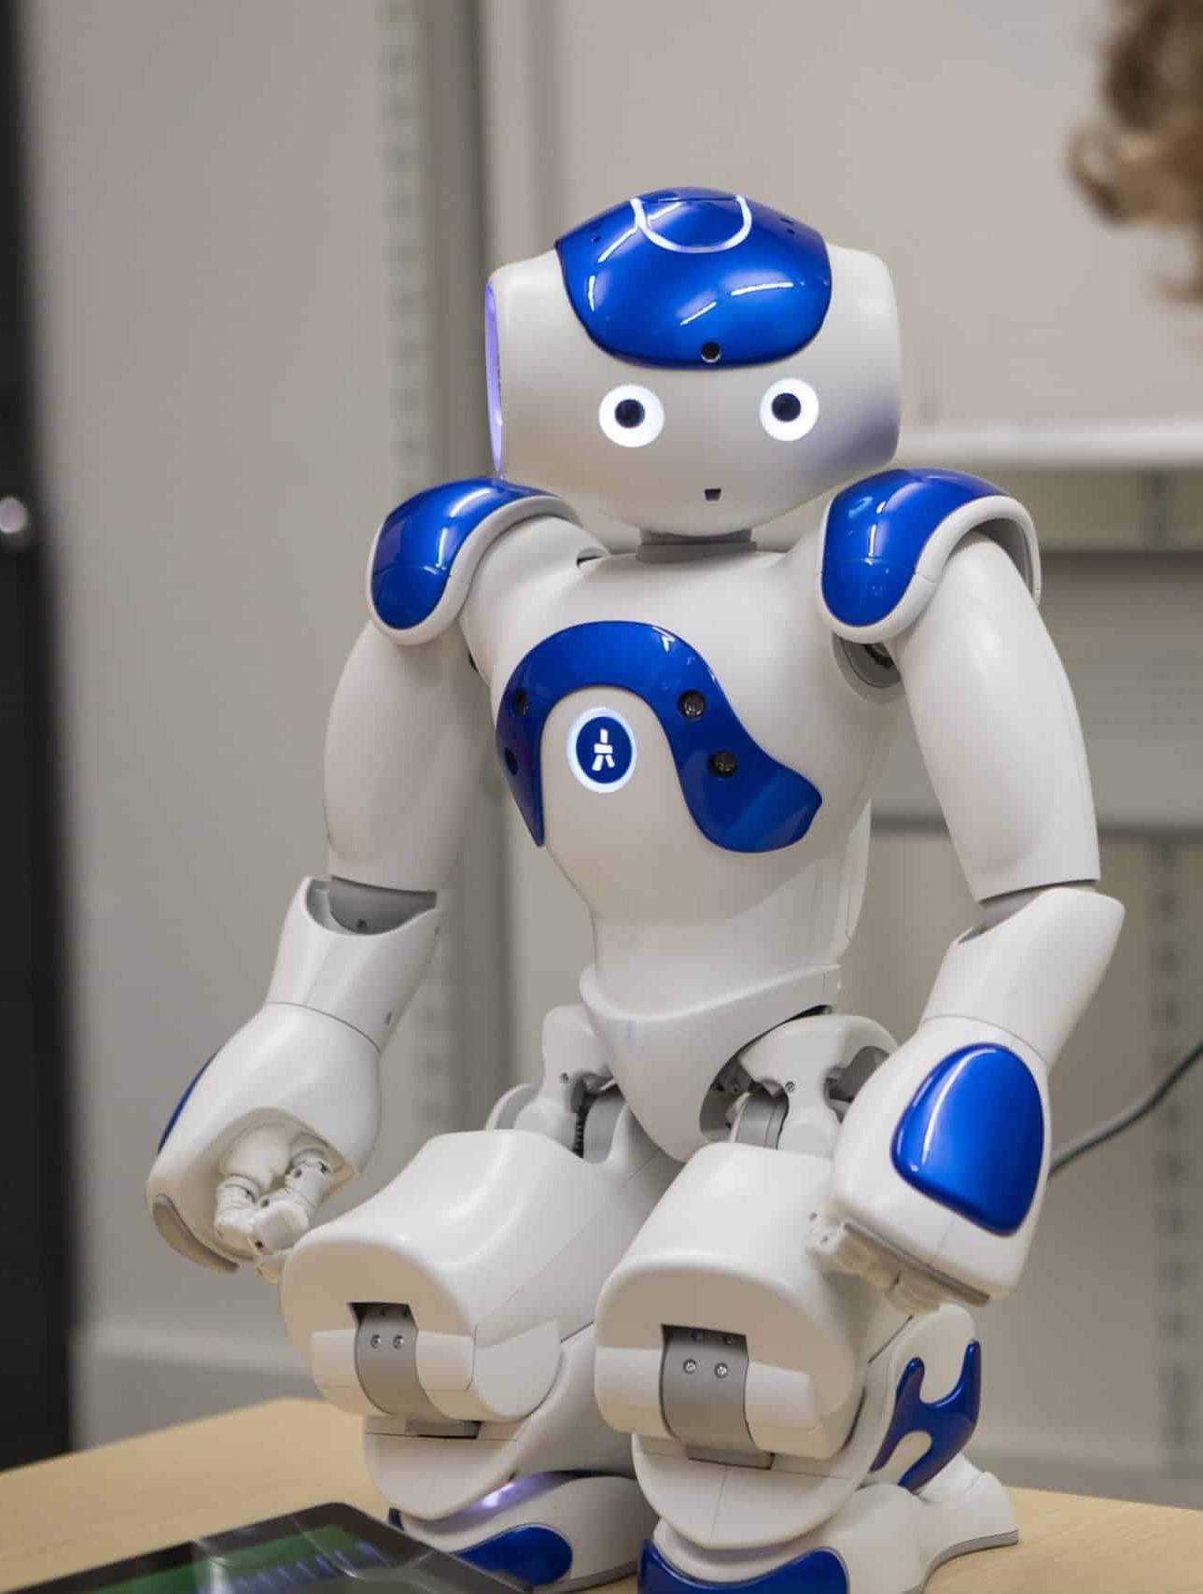
“It Not only Matters Where You Stay but also How You Stay.”
HOTECH
Introducing…….

Slide 14
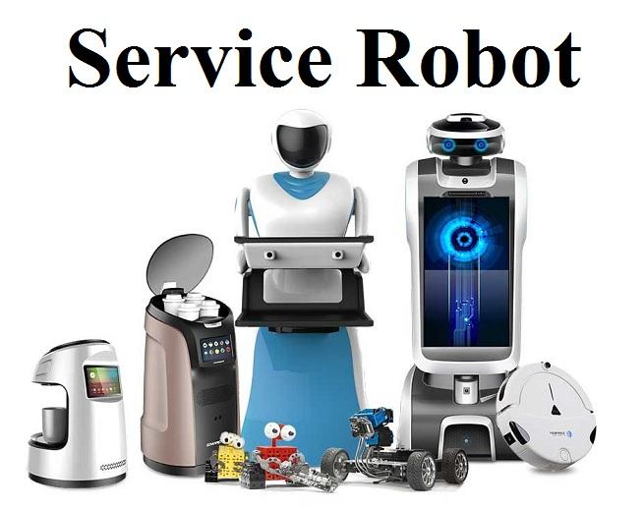

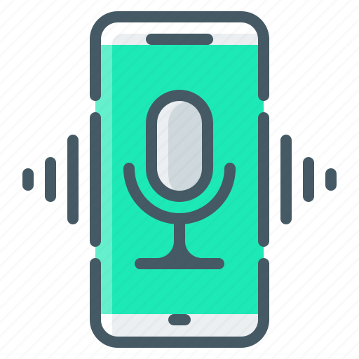
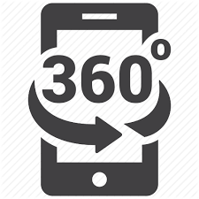
Guests want info and answers at the touch of a button and the spread of Covid-19 has boosted implementation of service robots in the hospitality industry as more customers become more sensitive to risk of infectious disease from interpersonal interactions.
Furthermore ,it is expected that by the year 2030 hospitality technology will be very common and the main competitive element between hotels. Hotels, therefore, need to leverage the resources and systems at their disposal if they hope to retain loyal clients.
Chat bots Voice assistants Virtual reality
in apps and web videos showing 360
view of hotel rooms
Introducing the above digital features in the Hilton channels and service robots like
front desk robots , delivering robots would turn customer satisfaction to customer
delight.

Slide 15
FOCUS ON CUSTOMER SEGMENTATION
GLOBAL AI INFLUENCE ON TRAVELERS(%)
75% of Chinese travelers would be influenced by AI
Chinese people are showing more interest staying in hotels with digital environment . Also , China stands in Top 5 countries as the most popular tourist destinations with roughly 66 million visitors .
So , introducing HOTECH in top Hilton hotels in China would attract customers and stand against it’s competitive hotels as many hotels in China are already advanced in using AI .
31% of German , US & UK travelers would be influenced by AI
QUICK FACT
According to the latest research conducted by Colliers International, personalization Artificial Intelligence (AI) could increase hotel revenues by over 10% and reduce costs by more than 15% – with hotel operators expecting technology such as voice and facial recognition, virtual reality and biometrics to be mainstream by 2025.

Slide 16
GEOGRAPHIC SEGMENTATION
Hilton is experimenting with a robot concierge named Connie(2016) in Hilton Mc Lean. Similarly, it must be introduced in top hotels in USA , Canada , United Kingdoms , Japan since customers are showing more interest in domestic leisure travels due to covid 19 impact .

Slide 17
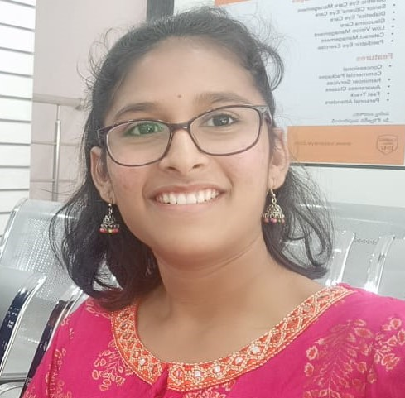
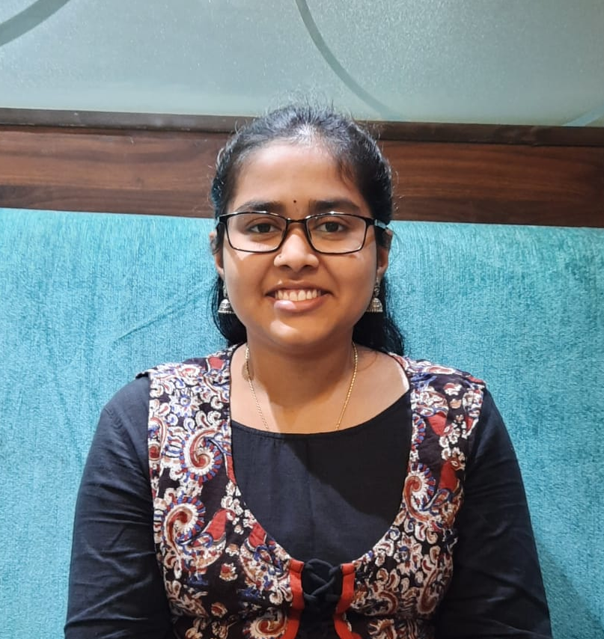

OUR TEAM
NAVYA SREE
RUCHITA
SHRAVANI
IIT ISM DHANBAD
B Tech in Environmental Engineering
IIT ISM DHANBAD
B Tech in Mechanical Engineering
IIT ISM DHANBAD
B Tech in Chemical Engineering

Slide 18
ANALYSIS WORKSPACE
(All the data shown are calculated for the last 6 full months)

Slide 19
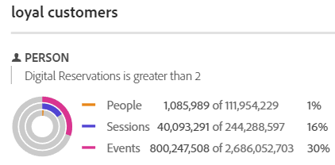
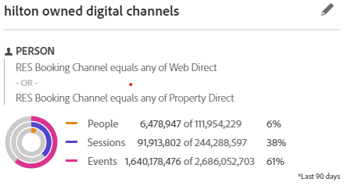
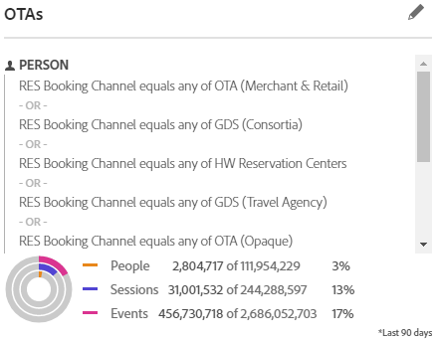
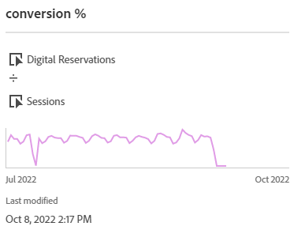

Slide 20
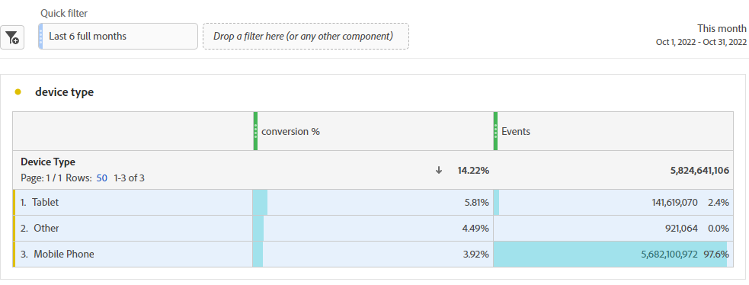
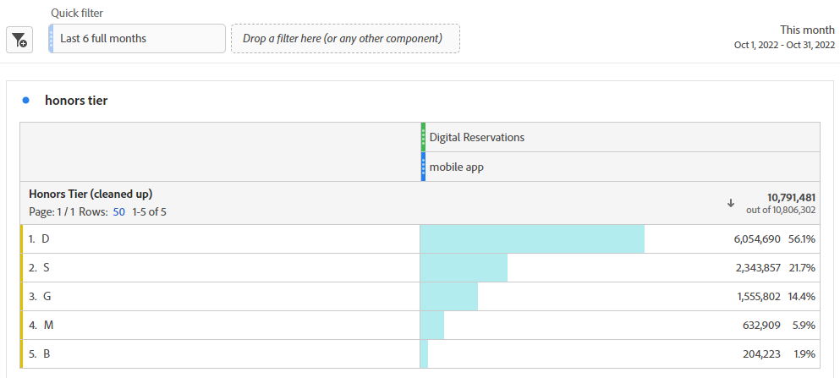
TABLES

Slide 21
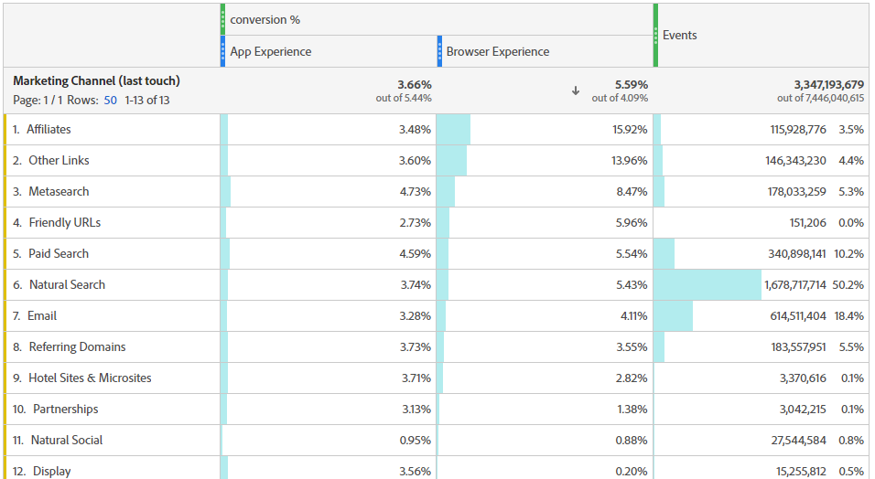

Slide 22
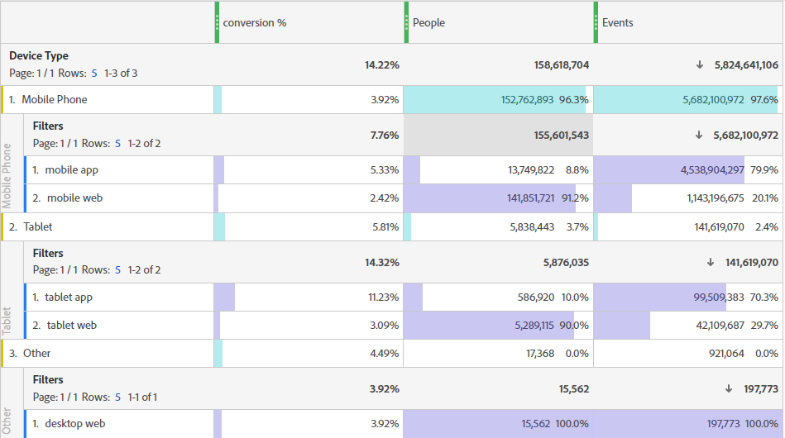

Slide 23
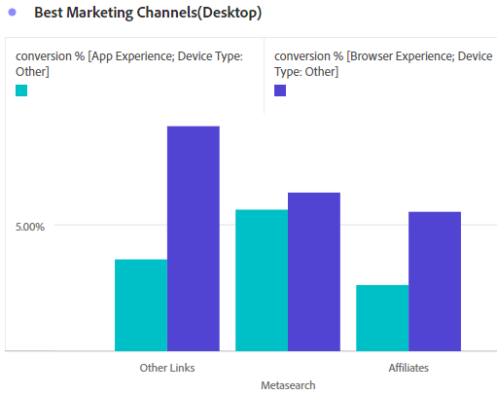
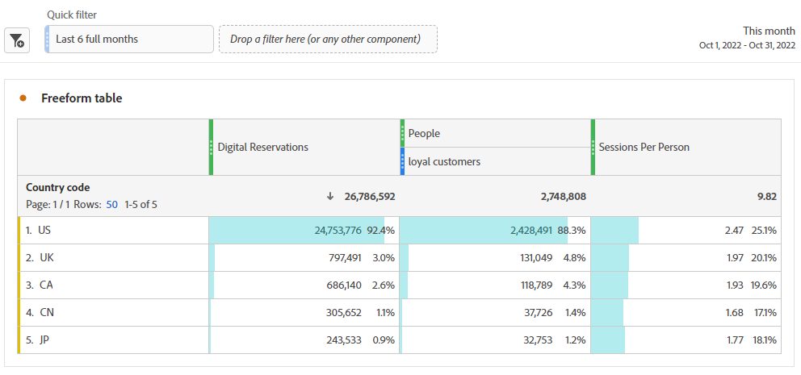

Slide 24
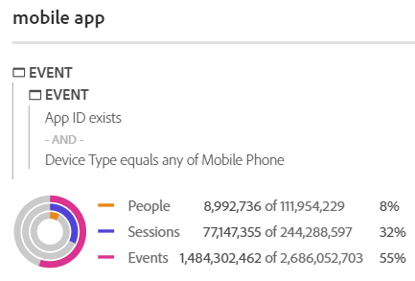
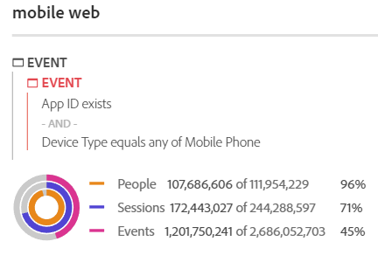
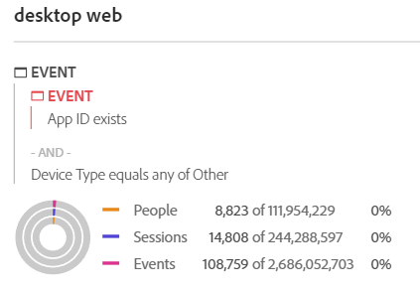
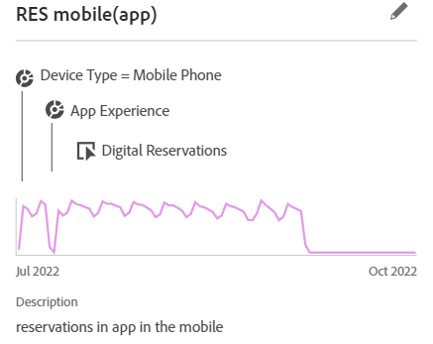
FILTERS

Slide 25
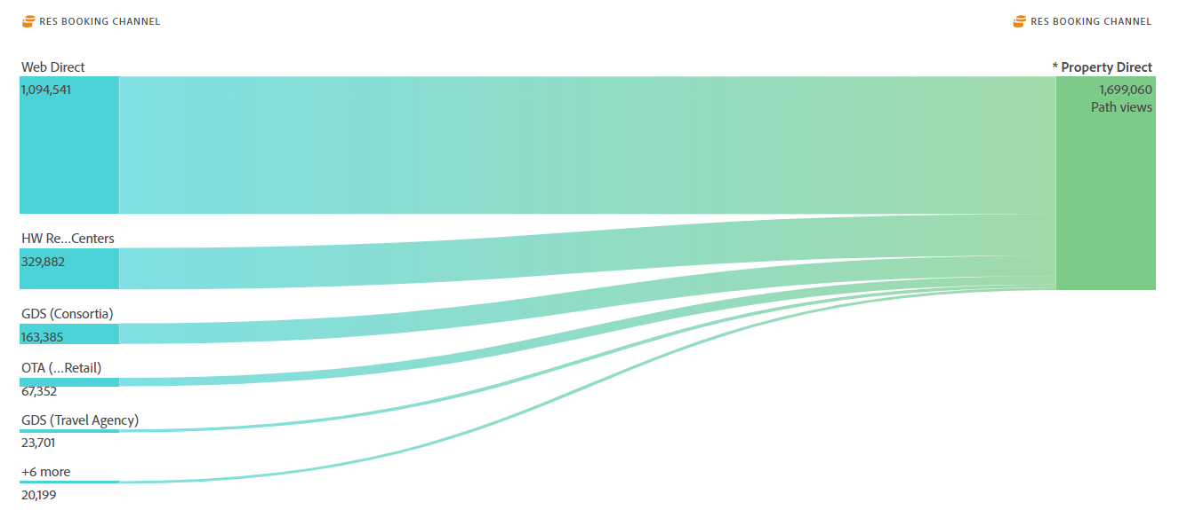
RES booking channels FLOW

Slide 26
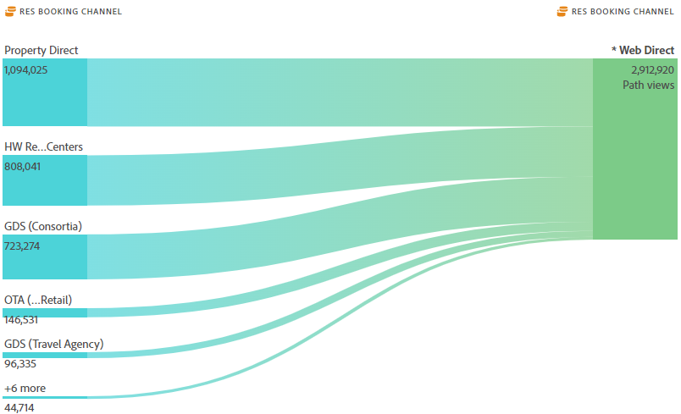

Slide 27
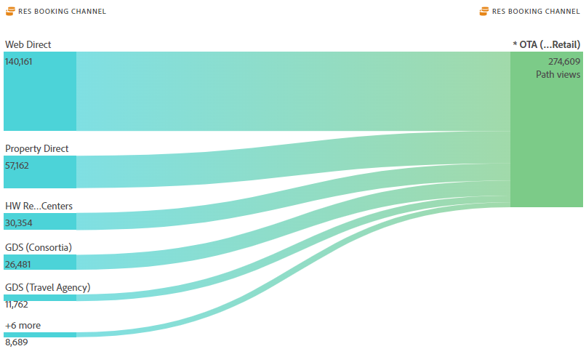

Slide 28
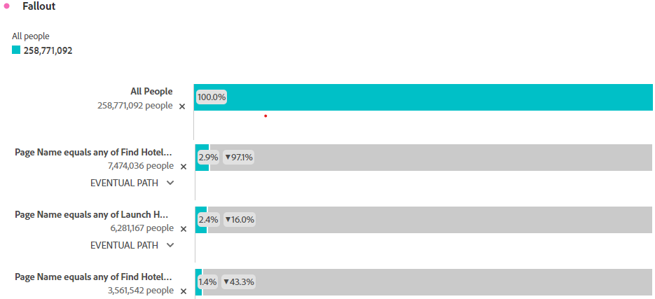
FALL OUT

Slide 29
THANK YOU

